Slide 1
PPAP Requirements Training
Rev. A 08/08/14

Slide 2
What is PPAP?
Production Part Approval Process (PPAP)
The purpose of PPAP is to determine if all customer engineering design record and specification requirements are properly understood by the Suppliers and the manufacturing process has the capability to produce product consistently meeting these requirements during an actual production run at the quoted production rates

Slide 3
PPAP Level Definitions
Level 1 PPAP:
• One page document that “warrants” the part meets the design requirements known
as a Part Submission Warrant.
Level 2 PPAP:
• Part Submission Warrant (PSW)
• Dimensional Results – per cavity
• Design Records (Bubble Print)
• PPAP Samples – First production order / upon request prior to production order
• Print Notes (Attach copy of Raw Material Certification / Performance Test Report / Surface
Finish / Labeling, Paint Process, Welding)
• Supplier Change Request
Level 3 PPAP: Includes Level 2 PPAP requirements PLUS…
• Dimensional Results
• Process Flow Diagrams (PFD)
• Failure Mode and Effects Analysis’ (PFMEA / DFMEA)
• Process Control Plans
• Initial Process Capability Studies – if applicable
• Measurement System Analysis – if applicable
• Appearance Approval Reports (AAR) – if applicable
• Checking Aids – if applicable
• Records of Compliance with Customer Specific Requirements
• Master Sample Photo Documentation of PPAP parts
• Tooling Photo Documentation – if applicable
Level 4 PPAP
• Part Submission Warrant (PSW)
• Dimensional Results
• Design Records (Bubble Print)
• PPAP Samples
Long Term
Benefit

Slide 4
PPAP Workbook – Level 2 Requirements
INTRO:
Type in Part / Supplier Information, this will be transferred throughout the workbook.
PPAP REQUIREMENTS:
This outlines the PPAP submission requirements. (Informational only)
LABELING:
This is the label to be used to Identify the PPAP sample part when shipped to HED
PSW:
This documents the warrant that the Part Meets the design Intent
This will be used to communicate back to the supplier the acceptance or rejection of the PPAP
DIMENSIONAL:
This is used in conjunction with a “bubble print” to document the actual dimensions of the PPAP part.
PRINT NOTES:
This is used to document all the remaining notes on print (Attach copy of Raw Material Certification / Performance Test Report
/ Surface Finish / Labeling, Paint Process, Welding)
PRINT NOTES – PAINT:
This is optional depending if there are Print Notes specifying paint / coating requirements.
PRINT NOTES – WELDING:
This is optional depending if there are Print Notes / Welding requirements specified.
Required Always
Required where applicable

Slide 5
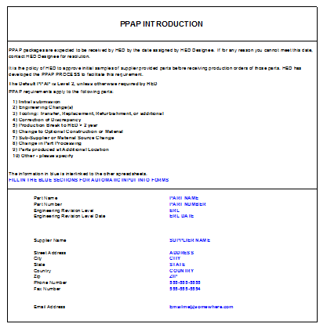
Intro “TAB” – PPAP Workbook
1. Part Information
2. Supplier Information
Note: This information will
Be transferred to all “like” fields
In this PPAP Workbook.
1
2
Required Always
Required where applicable

Slide 6
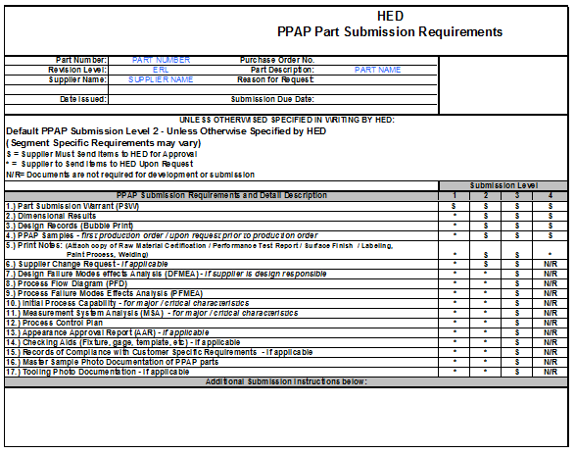
PPAP Submission Requirements
1
2
Level 2 Submission is the Default PPAP level.
2. List of what is Required based on submission level (Level 1, 2, 3, 4)
Required Always
Required where applicable

Slide 7
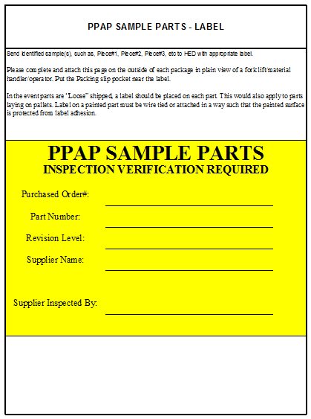
PPAP Parts Labeling Requirements
1
All PPAP sample parts must be tagged with this label on the part and / or on the box
2. Document all the appropriate Part / Supplier / PO information on the label.
2
Required Always
Required where applicable

Slide 8
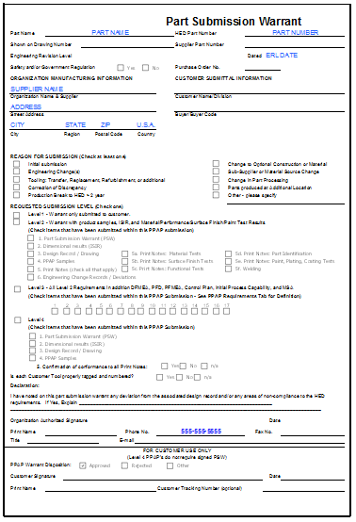
PSW – Part Submission Warrant
1
2
3
5
4
8
6
7
9
10
Note: All fields must be completed. If an area is not applicable mark as “N/A”. Below is a definition of what each “numbered” section is.
11
1.) Name of part on drawing
2.) HED part number on PO/drawing
3.) HED part number on drawing
4.) Supplier part number if applicable (n/a if not)
5.) Engineering change level (ex. Rev B, this will be on the drawing / PO)
6.) Engineering date (ex. 4/7/14, this will be on the drawing / PO)
7.) Is this Safety / Government regulation (ex. Drawing will indicate if it is FMVSS, or other industry standard safety regulations.
8.) PO number driving demand for this part / PPAP.
9.) This section requires all applicable supplier location information
10.) Buyer Name
11.) Materials Reporting, acknowledgment the parts meet the hazardous material restrictions outline per the drawing, supplier standards guides or other contract flow down requirements
12.) Check the reason for the PPAP submission
13.) Check the Level of PPAP that was requested by HED and check what documents in the PPAP have been submitted that are applicable for this component
14.) If supplier has HED owned tooling document here.
15.) Supplier point of contact information
**DO NOT LEAVE ANY SECTION BLANK. N/A IS OK WHERE NECESSARY**
12
13
14
15
Required Always
Required where applicable

Slide 9
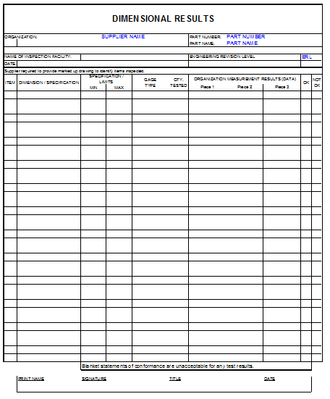
DIMENSIONAL RESULTS
3
4
1
2
5
6
ITEM: Numbering needs to match Design Records / “Bubble Print”
DIMENSIONAL / SPECIFICATION: Mark the low & high values in the MIN / MAX respectively
GAGE TYPE: Mark the gage used to measure item
QTY TESTED: Mark how many parts measured (at a minimum 1 piece per cavity if applicable)
DATA: Mark actual results
OK / NOT OK: Check each measurement as good or bad by marking OK / NOT OK appropriately
SIGNATURE SECTION: Fill in Name, Signature, Title and Date for supplier sign off
Required Always
Required where applicable
7

Slide 10
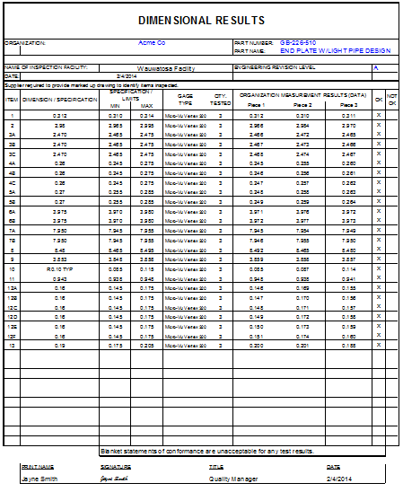
DIMENSIONAL RESULTS: SAMPLE
Required Always
Required where applicable

Slide 11
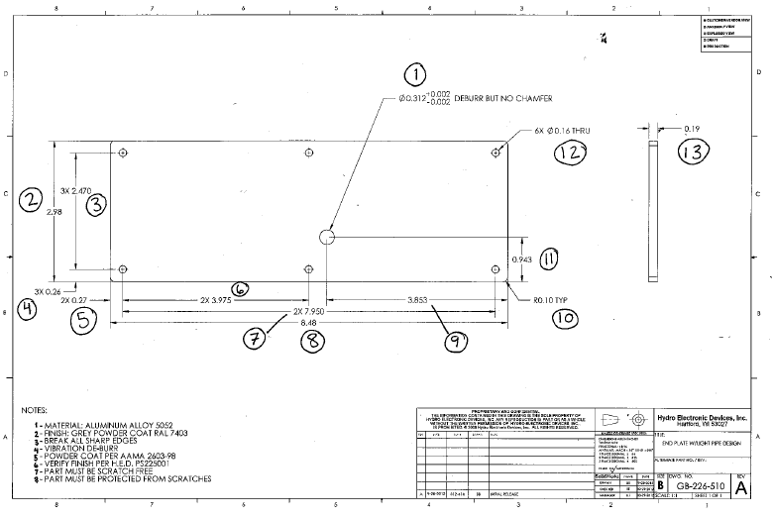
DESIGN RECORD / BUBBLE PRINT: SAMPLE
Make sure Design Records (Bubble Print)
Matches Dimensional Results’ numbering
Include Notes (word for word) in the specification section of “PRINT NOTES”
1. MATERIAL: Aluminum alloy 5052
2. FINISH: GREY POWDER COAT RAL 7403
3. ETC…..

Slide 12
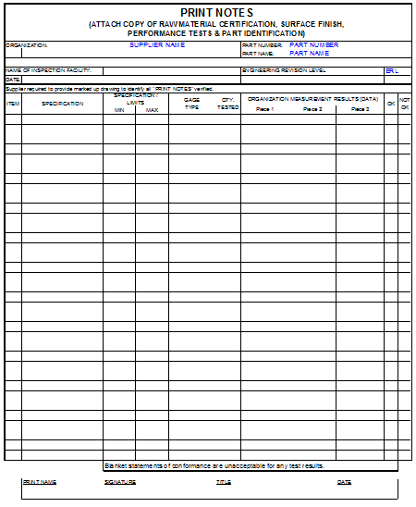
PRINT NOTES (ATTACH COPY OF RAW MATERIAL CERTIFICATION, SURFACE FINISH, PERFORMANCE TESTS & PART IDENTIFICATION)
3
4
1
2
5
6
ITEM: Numbering needs to match Design Records / “Bubble Print”
DIMENSIONAL / SPECIFICATION: Mark the low & high values in the MIN / MAX respectively
GAGE TYPE: Mark the gage used to measure item
QTY TESTED: Mark how many parts measured
DATA: Mark actual results
OK / NOT OK: Check each measurement as good or bad by marking OK / NOT OK appropriately
SIGNATURE SECTION: Fill in Name, Signature, Title and Date for supplier sign off
Note: This sheet to be used to document all Print Note
requirements via the “bubble print” and reference any
applicable Test report numbers in the PPAP package
Required Always
Required where applicable
7

Slide 13
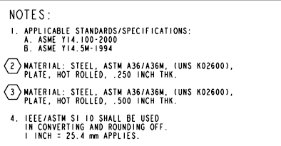
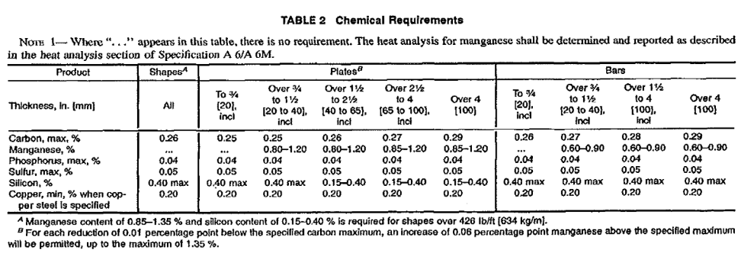
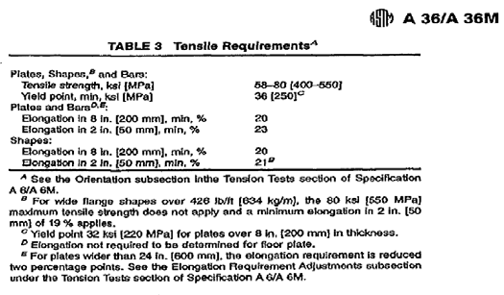
PRINT NOTES: SAMPLE
Design Record Requirement
ASTM Chemical Requirement
ASTM Mechanical Requirement
PPAP document to outline requirement and actual’s per the print and industry standard (ASTM)
**NOTE**
If material certification is the same specification on the drawing, the chemistry and mechanical requirements do not need to be on the Print Notes PPAP sheet. Certifications need to be provided & referenced.
1
2
3
4

Slide 14
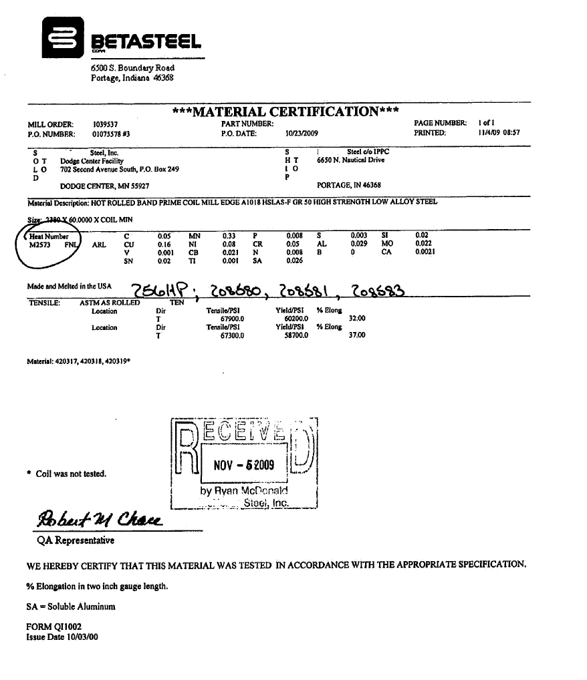
PRINT NOTES: SAMPLE CERT PROVIDED
Use Chemical Weighted % from material cert. and transfer to print notes PPAP page.
Mechanical Results to be transferred to print notes PPAP Page.
Signature on Cert. approving material
1
2
3

Slide 15
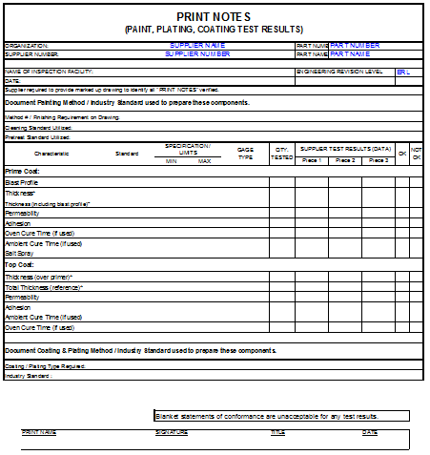
PRINT NOTES – PAINT (Includes Paint, Plating & Coating Testing)
Document what print standard, Industry Standard, & Process Steps that were used to coat the part
Prime Coat Verification: Permeability, Adhesion, Thickness Salt Spray Results, Ambient Cure Time & Oven Cure Time
Top Coat Verification: Permeability, Adhesion, Thickness, Salt Spray Results, Ambient Cure Time & Oven Cure Time
Document plating / coating process Utilized to manufacture this part
Supplier Sign Off
1
2
3
4
5
Required Always
Required where applicable

Slide 16
PRINT NOTES – PAINT: SAMPLE
1
Print Note Paint Note Requirement
Document what print standard or Industry Standard the part has been painted to.
Prime Coat Verification
Reference standard for each process step
Document blast profile
Document actual thickness including profile
Ensure that the thickness includes blast (1.0mil blast profile + 1.3 mil primer = 2.3 min thickness including blast profile)
Top Coat Verification
Supplier Sign Off
2
3
4
5

Slide 17
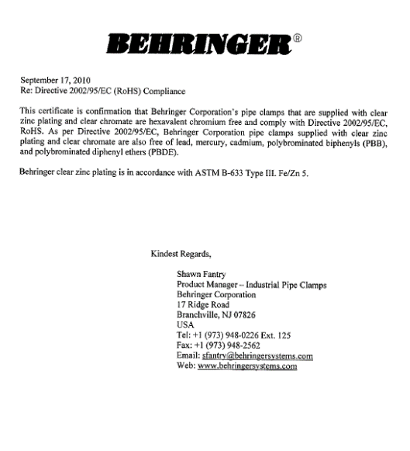
PRINT NOTES – PAINT: Plating Sample
Print Note: Plating Requirement
Technical drawing requirement
Document process required & document standard process executed to plate part
Provide Material certification
Supplier Sign off
1
2
3
4
5

Slide 18
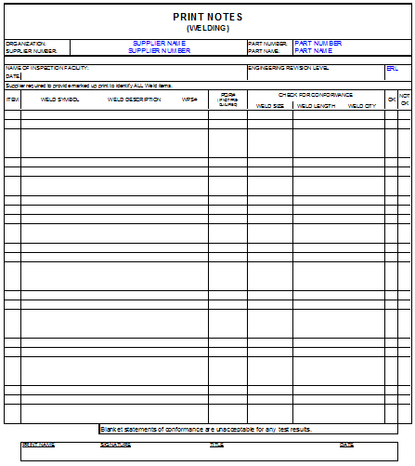
Welding Specification
2
3
1
Document the Welding Symbol / Weld Description from “bubble print”
Document WPS / PQR (if not prequalified)
Document visual verification of weld size, Weld length, Weld Quality
Supplier Sign Off
Note: WPS’s and PQR’s may be requested and must be provided upon request
Required Always
Required where applicable
4

Slide 19
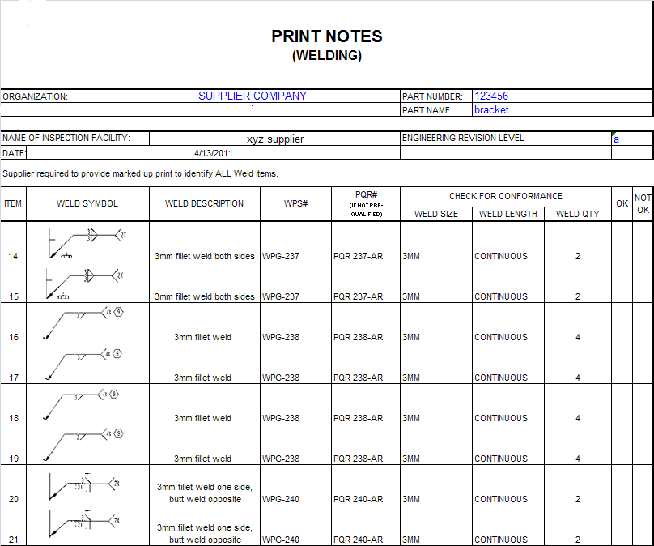
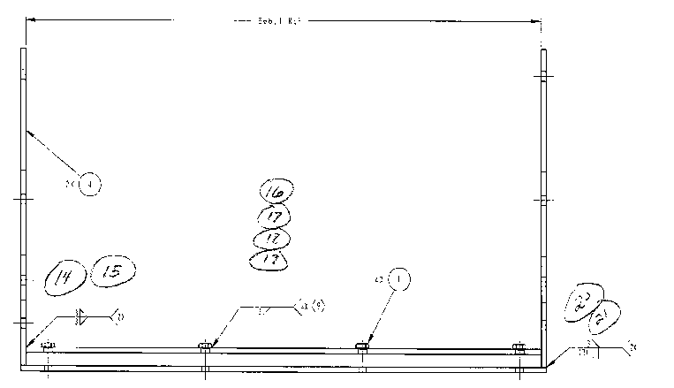
Example: Welding Specification
Document the Welding Symbol / Weld Description from “bubble print”
Document the Welding Specification / Weld Symbol from “bubble print”
Document WPS / PQR (if not prequalified)
Document visual verification of weld size, weld length, weld quality
Supplier sign off
Note: WPS’s and PQR’s must be provided upon request
2
3
4
1
5

Slide 20
PPAP Workbook – Level 3 Requirements
LEVEL 2 - PPAP
LEVEL 3 - PPAP
Same Requirements as Level 2 with the following additional requirements:
DFMEA
Design Failure Mode Effects Analysis is required if the Supplier is design responsibly
FLOW DIAGRAM
Process Flow diagram is required to outline and standardize the production process that is being approved. This should outline the entire process that is being used to manufacture the
component & assembly.
PFMEA
Process failure Mode Effects Analysis is required to be conducted to understand all the potential failure modes and mitigate know failure modes.
CONTROL PLAN
The control plan is to be used to document and be used on the shop floor to monitor and control the standardized manufacturing process being approved.
MASTER SAMPLE:
This is used to document visually how the parts are being marked and pictures of the PPAP parts.
TOOLING
This sheet is used to visually document any HED owned tooling.
CAPABILITY STUDY
This sheet is to be used to show evidence the production process is capable to meet the design intent. This is required when
Critical Characteristics are identified on the print or other wise specified by HED
GAGE R&R
This sheet is to be used to show evidence that the measuring method used for the capability studies is repeatable and reproducible.
Required Always
Required where applicable

Slide 21
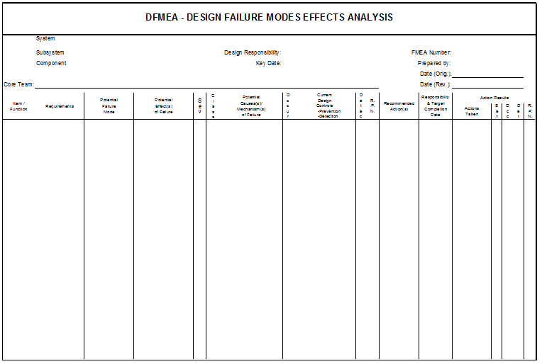
DFMEA
Design Failure Mode Effects
Analysis is required ONLY if the
Supplier is design responsible
Required Always
Required where applicable

Slide 22
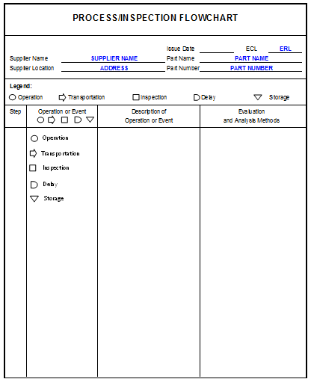
Process Flow Diagram
Process Flow diagram is required to outline and standardize the production process that is being approved. This should outline the entire process that is being used to manufacture the component / assembly
Required Always
Required where applicable

Slide 23
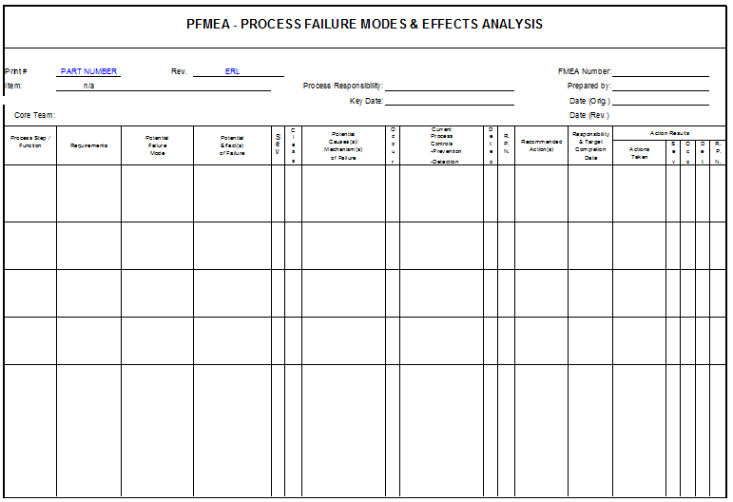
PFMEA
Process Failure Mode Effects analysis is required to be conducted to understand all
the potential failure modes
and mitigate any known failure modes.
Required Always
Required where applicable

Slide 24
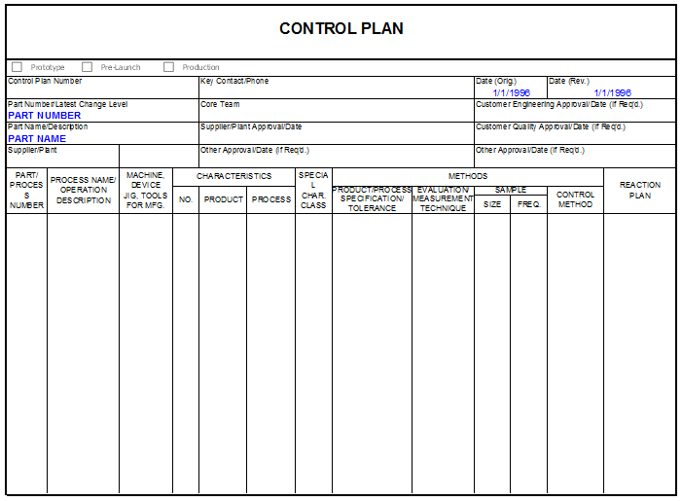
Control Plan
The Control Plan is to be used to document and be used on the shop floor to monitor and control the standardized manufacturing process being approved.
Required Always
Required where applicable

Slide 25
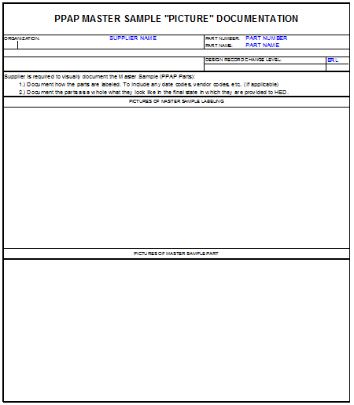
Master Sample
This section for visually documenting how the parts are being labeled
This section for visually documenting how the PPAP parts look
1
Required Always
Required where applicable
2

Slide 26
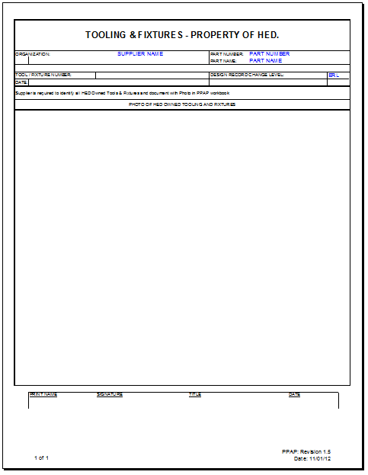
Tooling – HED Owned
This sheet is used to visually document any HED owned tooling. It is required to attach a picture of tooling as well as the tooling identification method.
Required Always
Required where applicable

Slide 27
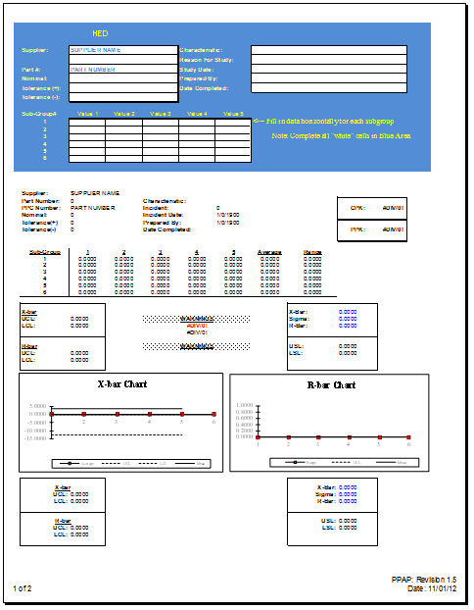
Capability Studies
This sheet is to be used to show evidence that the production process is capable to meet the design intent. This is required when Critical Characteristics are identified on the print or otherwise specified by HED
Required Always
Required where applicable

Slide 28
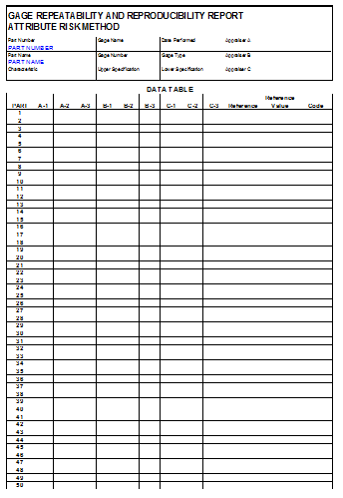
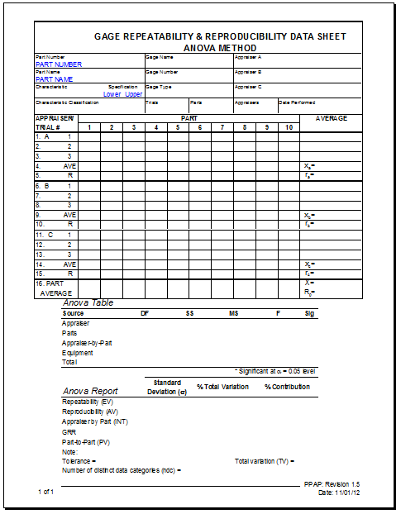
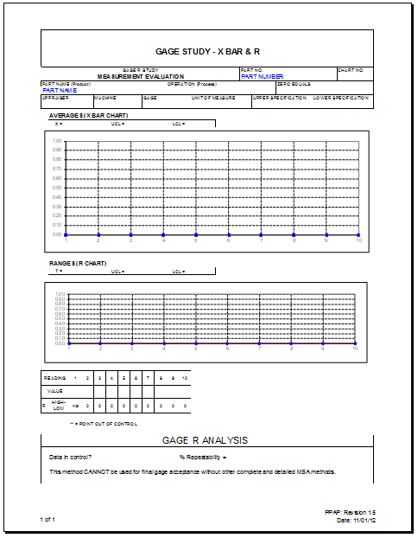
Gage Repeatability & Reproducibility (Gage R&R)
There are multiple examples of Gage R&R forms to use. Use the appropriate form to provide evidence that the measuring method used for the Capability Study is repeatable and reproducible.
Required Always
Required where applicable

Slide 29
PPAP Workbook – Level 4 Requirements
INTRO:
Type in Part / Supplier Information, this will be transferred throughout the workbook.
PPAP REQUIREMENTS:
This outlines the PPAP submission requirements. (Informational only)
LABELING:
This is the label to be used to Identify the PPAP sample part when shipped to HED
PSW:
This documents the warrant that the Part Meets the design Intent
This will be used to communicate back to the supplier the acceptance or rejection of the PPAP
DIMENSIONAL:
This is used in conjunction with a “bubble print” to document the actual dimensions of the PPAP part.
Required Always
Required where applicable

